Slide 1
Thread and Process Communication
Lecture 2 of 3
Pipelines
Note: Examples of the concepts presented here can be found in the RTExamples folder: Q7 & Q7A
You are encouraged to open the project(s) in Visual Studio and run the program(s)
©Paul Davies 2020. Not to be copied, used, or revised without explicit written permission from the copyright owner. This lecture may contain animations and is best viewed as a slide show

Slide 2

Inter-Process Communication - The Pipeline
A pipeline provides for sequential (i.e. non random access) data transfer between two programs on a first-in, first-out (FIFO) basis.
Pipelines may be unidirectional or bi-directional depending upon their implementation (the version in the RT library is uni-directional – use two for bi-directional comms).
The read operation is destructive, that is, data read from the pipeline can be considered lost unless a copy of it is saved by the program reading it, i.e. the data cannot be re-read.
Any write operation results in new data being appended to the end of the pipeline where it is held until such time as it is read.
Data In
Data Out
MASCOT 3 Symbol for a Pipeline

Slide 3
The Physical Realisation of a Pipeline
Pipelines are generally implemented as a ‘wrap-around’ buffer, i.e. a circular queue data structure (see below) using memory allocated by the OS Kernel. In the RT library this shared memory is actually implemented as a datapool.
When the buffer has been filled due to writing, it will ‘wrap-around’ and begin to overwrite previous data.
Likewise a process that has read all the data in the pipeline would similarly ‘wrap-around’ and begin to re-read the same data again.
Care must therefore be taken in the implementation of a pipeline to ensure that data is not overwritten or re-read by accident, i.e. the implementation must implement some form of inherent synchronisation between the two programs reading and writing data so that one does not get too far ahead of the other.
Buffer Top
Pointer to Writing
Position
Pointer to Reading
Position
Buffer Bottom

Slide 4
Important Pipeline Synchronisation Properties: Writing
Any process attempting to write data to a Pipeline which is either full or has insufficient free space to accommodate the full write request will be suspended by the OS until such time as there is space available to complete the write.
This is to prevent data being lost if the circular buffer were to overflow and attempt to wrap around on itself.
A process will be unable to detect if it was suspended and woken up later.
Write Operation Blocked
FULL Pipeline

Slide 5
Important Pipeline Synchronisation Properties: Reading
Any process attempting to read data from a pipeline which has insufficient data to satisfy the full read request will also be suspended by the kernel until there is sufficient information to complete the transaction.
This is to prevent a reading process accidentally reading the same data twice, should the buffer wrap around.
Again a process will not be able to detect if it was suspended and woken up later.
Empty Pipeline
Read Operation Blocked

Slide 6
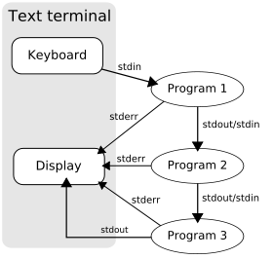
Many operating systems (UNIX, Windows etc.) including real time embedded operating systems such as VxWorks, OS9/68k etc. support pipelines, either to route the output of one program to the input of another, or to direct serial communication with IO devices.
In Windows we can create “anonymous/unnamed” pipes using commands such as myprogram1.exe | myprogram2.exe > file.txt
This also represents a form of inter-process communication. In this case it is the OS “Shell” that creates the pipes by calling the kernel, but we can create them under software control also.

Slide 7
Using a Pipeline – The RT Library
A pipeline is accessed using a number of software primitives with hooks to the operating system kernel to handle the suspension and resumption of processing. Such primitives include the ability to:-
  Create and Open a name/sized pipeline for reading or writing.
  Read data from a pipeline.
  Write data to a pipeline.
  Delete a pipeline.
The problem with blindly reading from, or writing data to a pipeline is that a process/thread runs the risk of getting suspended if the read or write cannot complete due to a lack of data or space within the pipeline. This suspension could have a 'ripple' effect causing other processes to become suspended etc. For this reason, most kernels have a primitive with the ability to
  Check how much data or space is available to be read or
  written to/from the pipeline.
IMPORTANT Note RT Library: When your pipeline object is deleted or goes out of scope in your program, its destructor is called. The destructor unlinks from the pipeline and windows will destroy the memory allocated to the pipeline when everyone using it has unlinked (this is a common source of bugs for new programmers). This is not a limitation, it was designed to behave like this, some other OS’s do the same thing.

Slide 8
The RT Library : CPipe Class
The CPipe Class encapsulates five member functions to facilitate the creation and use of a pipeline within a program. These functions call the Kernel to make it happen and control the physical pipeline maintained by the Kernel
A more detailed description/ implementation of them can be found in rt.h and rt.cpp files.
  CPipe(char *Name, int size) - The constructor responsible for creating the named pipeline with a specified size
  BOOL Read(void *data, int size) - A function to read ‘size’ bytes of data from the pipeline and
  store it at the address pointed to by ‘data’. Returns true
  if the read is successful or false if it fails. Note that suspension is not deemed a failure.
  BOOL Write(void *data, int size) - A function to write ‘size’ bytes of data to the pipeline using data stored in memory at the address pointed to by ‘data’.
  Returns true if the write is successful or false if it fails. Note
  that suspension is not deemed a failure.
  int TestForData (void) - Returns the number of available bytes of data in the pipeline
  that can be read without the process getting suspended
  ~CPipe() - A destructor to delete the pipeline at the end of its use.
Example program Question 7 on Canvas demonstrates the use of Pipelines

Slide 9
Example Use of Pipelines: Program 1 – Writing the Data
#include "rt.h"
struct example { // structure template for the data to be written to the pipeline
int x;
float y;
};
// Some data to be written to the pipeline.
int i=5 , array[10] = { 1 , 2 , 3 , 4 , 5 , 6 , 7 , 8 , 9 , 0 }; // array of 10 integers
char name[15] = "Hello World"; // a string of up to 14 characters (plus 1 for null byte)
struct example mystruct = { 2, 5.5 }; // a structure with an int and a float
int main()
{
CPipe p1(“MyPipe”, 1024); // Create a pipe 'p1' with the name "MyPipe"
p1.Write(&i, sizeof(i)); // write a copy of the int 'i' to the pipe
p1.Write(&array[0], sizeof(array)); // write a copy of the int array to the pipe
p1.Write(&name[0], sizeof(name)); // write a copy of the string to the pipe
p1.Write(&mystruct, sizeof(mystruct)); // write a copy of the structure to the pipeline
return 0;
}
IMPORTANT: Do not write any kind of pointer into a pipeline. This includes any C++ class object e.g. a “string” as they contain hidden pointers (use a char array if you need a string). Can you think why?

Slide 10
Example Use of Pipelines: Program 2 – Reading the Data
struct example { // structure template for the data that we intend to read from pipeline
int x;
float y;
};
// Some variables to hold the read from the pipeline.
int i, array[10]; // array of 10 integers
char name[15]; // a string of up to 14 characters (plus 1 for the null byte)
struct example mystruct; // a structure with an int and a float in it
int main()
{
CPipe p1("MyPipe", 1024); // Create a pipe 'p1' with the name "MyPipe" and size = 1024
p1.Read(&i, sizeof(i)); // Read the int 'i' from the pipe
p1.Read(&array[0], sizeof(array)); // Read the array of integers' from the pipe
p1.Read(&name[0], sizeof(name)); // Read the string from the pipe
p1.Read(&mystruct, sizeof(mystruct)); // Read the structure from the pipeline
// Now print out the data read from the pipeline
cout << "i = " << i << "\n";
for (int x = 0; x < 10; x++)
cout << "array [" << x << " = " << array[x] << endl;
cout << name;
cout << "mystruct.x = " << mystruct.x; << “ mystruct.y = " << mystruct.y << endl;
return 0;
}
Important: Make sure data is read by receiver in the same order that it is written by sender

Slide 11
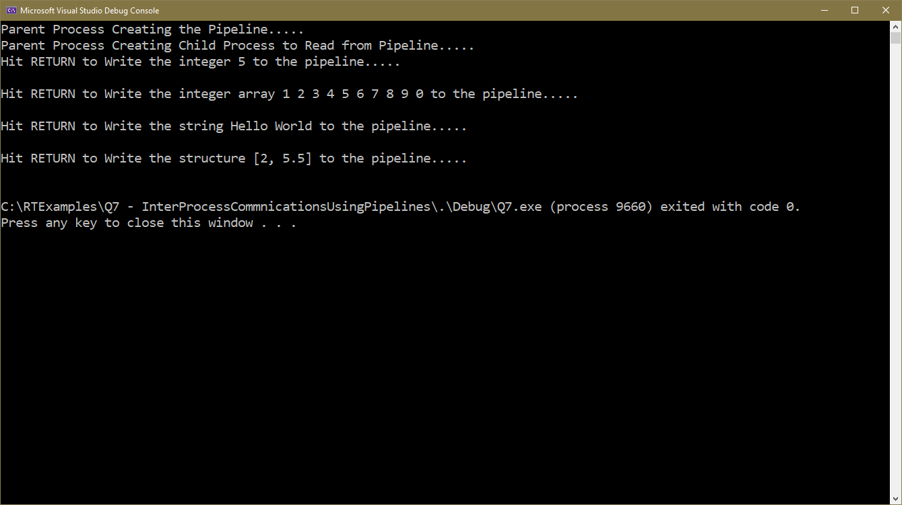
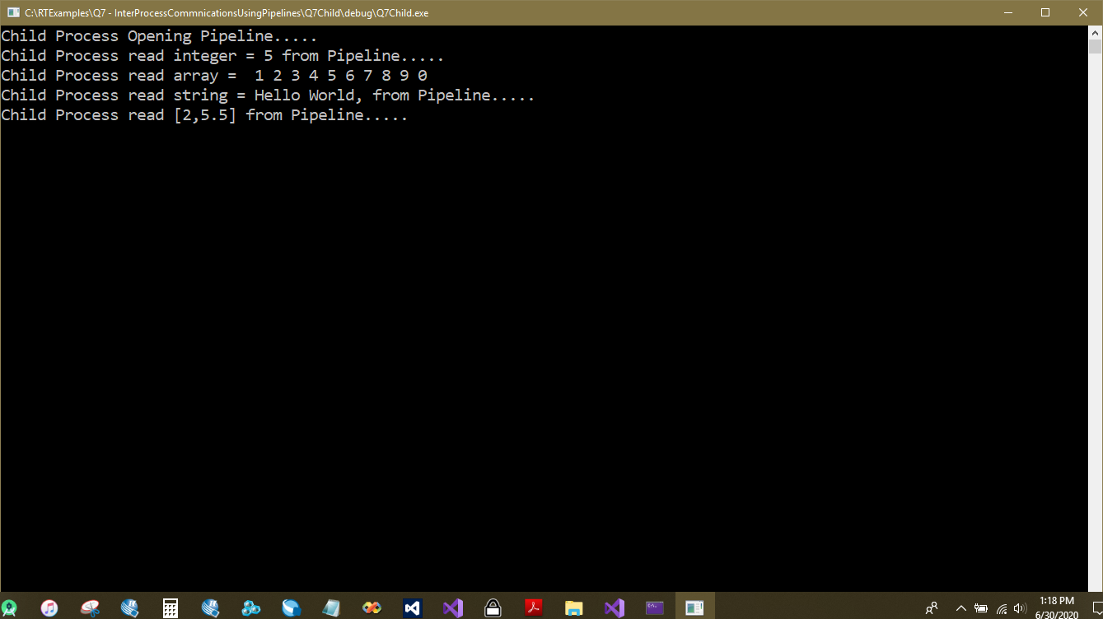
Output of Program Q7 Using pipelines

Slide 12
Handling Multiple Pipelines
Suppose a process is actively reading data from say 3 pipelines and maybe a keyboard (which has properties similar to a pipeline) as shown below. Because data could arrive along any pipeline at any time, the process will probably not be able to predict in advance which pipeline (or keyboard) to read first.
If process 1 were to make a guess at which pipeline holds data by attempting to read from it, it could get suspended if there is insufficient data to satisfy the read operation and the process would be unable to read data from any other pipeline.
These other pipelines would all eventually fill up and lead to their writers also getting suspended. How do we solve this ?
  Use the TestForData() Primitive, i.e. a polling approach.
  Use Multiple Threads inside the Process, one for each pipeline.
Process 2
p1
Process 3
p2
Process 1
Process 4
p3

Slide 13
Solution using Polling: TestForData()
#include "rt.h"
int pipe1data; // a single integer to be read from pipe 1, one at a time
float pipe2data[10]; // an array of 10 floats to be read from Pipe 1, one array at a time
char pipe3data[20]; // a string of up to 20 character to be read from pipe3, one array at a time
char KeyData[2] = { '\0', '\0' }; // a 2 character keyboard command initialised to be empty
int main()
{
CPipe p1("Pipe1", 1024); // create the three named pipelines
CPipe p2("Pipe2", 1024);
CPipe p3("Pipe3", 1024);
//Now generate an endless polling loop checking if any data has arrived from any of the four sources.
while (1) {
if ((p1.TestForData()) >= sizeof(pipe1data)) // if at least 1 integer in pipeline
p1.Read(&pipe1data, sizeof(pipe1data)); // read data from pipe
if ((p2.TestForData()) >= sizeof(pipe2data)) // if at least 10 floats in pipeline
p2.Read(&pipe2data, sizeof(pipe2data)); // read data from pipe
if ((p3.TestForData()) >= sizeof(pipe3data)) // if a 20 character string in pipeline
p3.Read(&pipe3data, sizeof(pipe3data)); // read data from pipe
//The primitive TEST_FOR_KEYBOARD() below tests the keyboard to see if any key
//has been pressed, if so it returns true (i.e. a value other than zero)
if (TEST_FOR_KEYBOARD() != 0 ) {
KeyData[0] = KeyData[1]; // move up previous character read
KeyData[1] = getch(); // read next character from keyboard with need for a return key press
}
}
}
See Q7A – Polling from RTExamples Folder
Check out CPU utilisation in task manager when running
Polling leads to Inefficient use of CPU Time

Slide 14
Multi-threaded approach
Advantage: A Thread reading from an empty pipe will still get suspended but other threads could continue, this is actually more efficient, since only those threads that can read data will receive CPU time, the others will be suspended.
Threads can communicate through shared data (variables) within the process but care must be exercised to ensure that the threads are synchronised so that only one thread can access that shared data at any one time (see topic on Mutual Exclusion in a later lecture).
See Q7A – Multiple Threads from RTExamples Folder.
Check out CPU utilisation in task manager when running
Process 2
p1
Process 1
Thread 1
Process 3
Thread 2
Thread 4
p2
Data
Thread 3
Process 4
p3
Multi threading leads to Efficient use of CPU Time

Slide 15
Type Safe Pipelines
The successful operation of a pipeline depends very much on the reader and writer process reading and writing the same type of data in the same order, e.g. an ‘int’, followed by a ‘float’, then a ‘double’ etc.
It would be useless and cause chaos in the system if for example one process wrote a ‘float’ into the pipeline, but another process chose to read that data as an ‘int’. It's not the pipelines fault if the reader and writer processes disagree about what data is in the pipeline.
To avoid these sorts of problems we could introduce an element of type-safety into our pipeline so that data of only one type could be stored thus avoiding any mix up.
Such a pipeline is represented by a C++ template class version of the Pipeline, called, not surprisingly CTypedPipe.
Such a typed pipeline would state that it can only be used to hold integers, or floats or structures of type ‘X’. An example of its use is shown overleaf.

Slide 16
Example Usage of a Type safe Pipeline: The RT Library
CTypedPipe <int> Pipe1("pipe”, 100) ; // create an 'int' pipe with space for 100 integers.
int main()
{
int x, i = 5, j = 0;
for (x = 0; x < 10; x++) {
Pipe1.Write(&x); // note size is implied by type of pipeline
cout << "Wrote " << x << " into Pipe. Num of ints in pipe = " Pipe1.TestForData() << endl;
}
for (x = 0; x < 10; x++) {
Pipe1.Read(&j); // note size is implied by type of pipeline
cout << "Read " << j << " from Pipe. Num of ints in pipe = " << Pipe1.TestForData() << endl;
}
return 0;
}
The type of data held by the pipeline
Returns number of items of data in pipe (i.e. number of int’s in this example) not number of bytes

Slide 17
Supplement: Other OS’s and Libraries that Support Pipelines
Windows
https://docs.microsoft.com/en-gb/windows/desktop/ipc/pipes
Linux
https://www.geeksforgeeks.org/named-pipe-fifo-example-c-program/
Boost
Uses the “async_pipe” type for pipelines https://www.boost.org/doc/libs/master/doc/html/boost_process/tutorial.html

